Slide 1
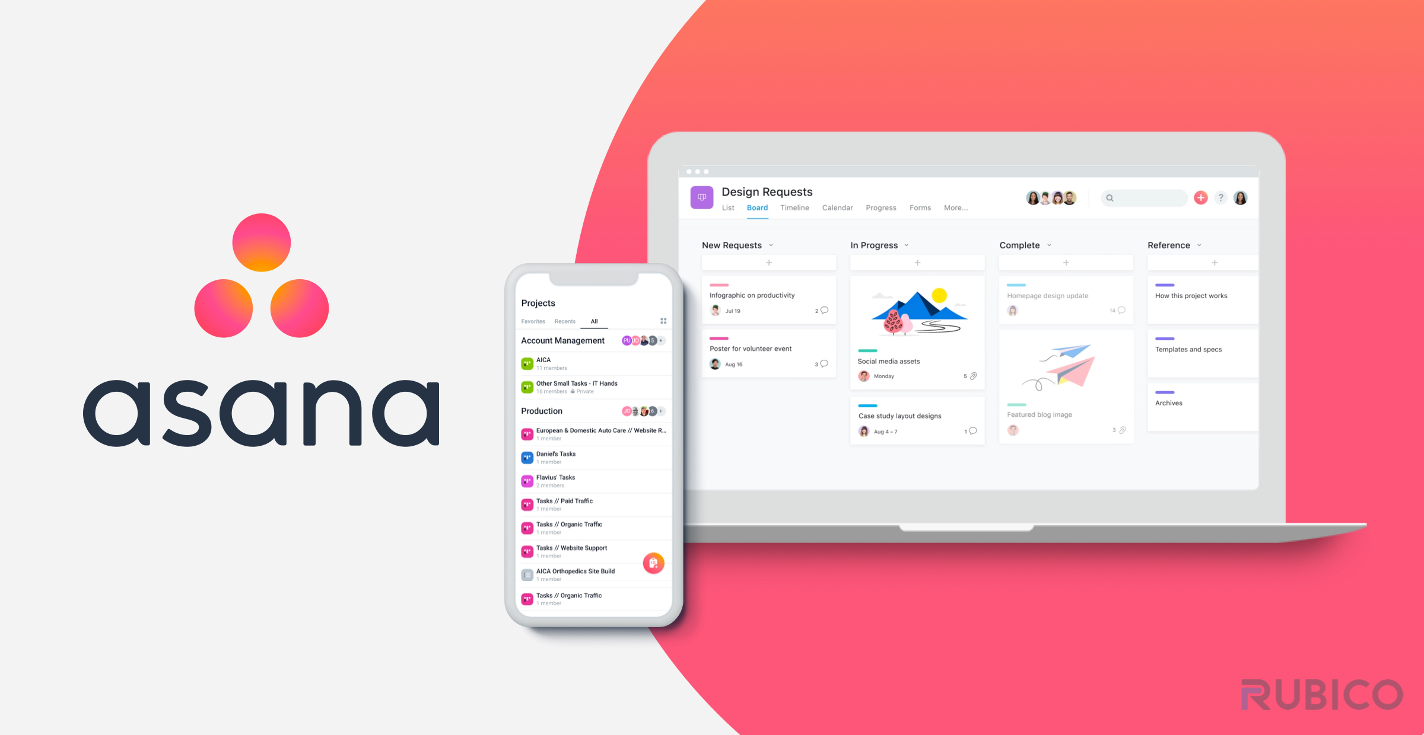
Laiba Binte Tahir
Arfah Ali
Availability of a free 30-day trial

Slide 2


Asana
Asana is a web and mobile application designed to help teams organize, track, and manage their work.
It offers a variety of features to facilitate collaboration, communication, and project management
It is a Licensed Software.

Slide 3
Work, project, and task management
Projects: Organize work into shared projects as lists or kanban boards.
Tasks: Assign tasks with clear ownership and due dates for accountability.
Subtasks: Break tasks into smaller parts for detailed tracking and execution.
Timeline: Visualize task and project deadlines in a Gantt-style view for better planning.
Dependencies: Define task dependencies to ensure proper task sequencing and workflow.
Templates: Use templates for consistent project execution and to save time on setup.

Slide 4
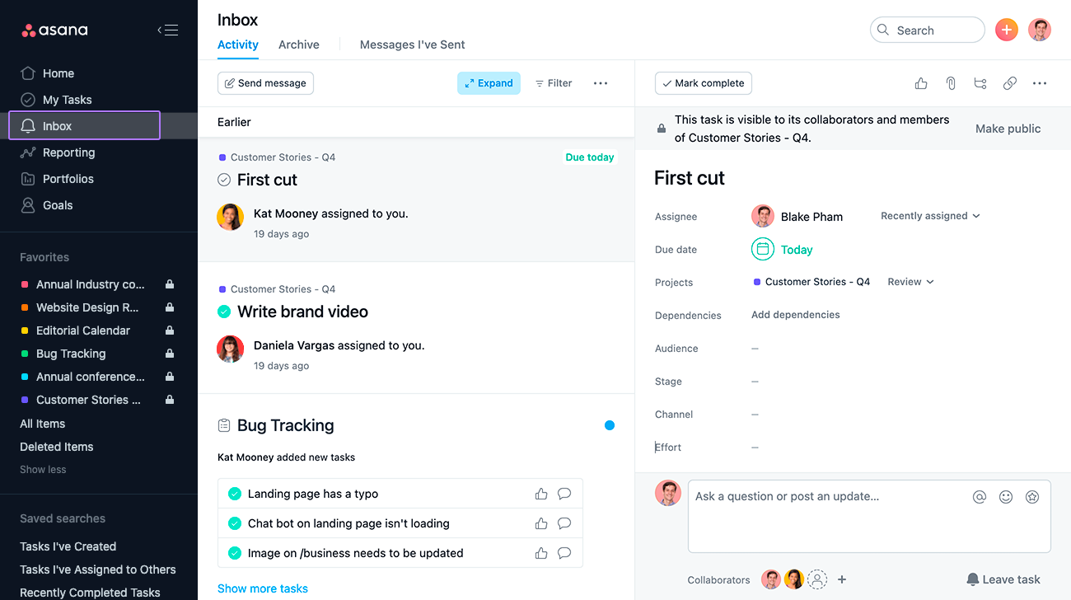
Communication
Task Comments: Clarify task details
Proofing: Give feedback on images or PDFs
Project Messages: Discuss project progress
Team Pages: Centralize team projects
Languages: Available language options
Source: asana

Slide 5
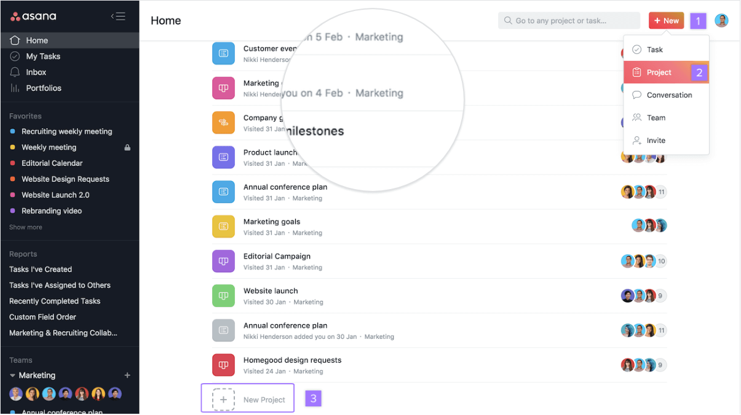

Slide 6
Views
My Tasks: Plan your day with a prioritized to-do list.
Inbox: Receive and filter notifications for projects, conversations, and tasks you're following.
List: Collaborate with your team using a grid-like structure for task creation, filtering, and formatting.
Search: Quickly find the work you need without painstaking organization.
Workload: View team bandwidth and make informed staffing decisions with Asana's resource management feature.
Calendars: Visualize task deadlines on a calendar for a clear view of due dates.

Slide 8
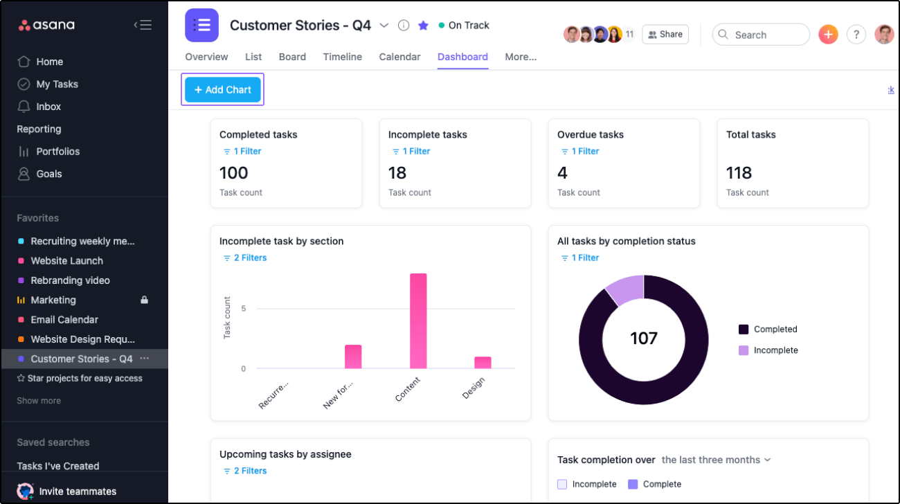
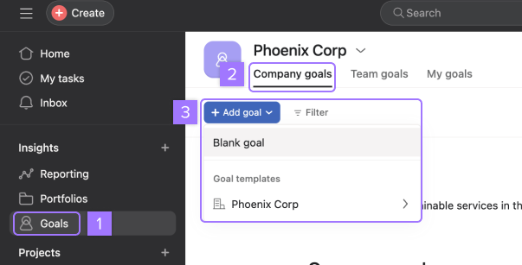
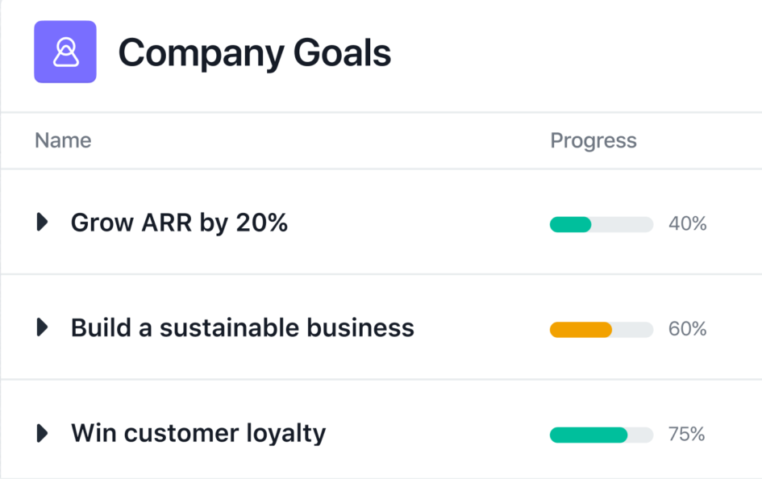
Reporting
Goals: Set and track company goals and track project progress
Dashboard: Analyze work progress

Slide 9
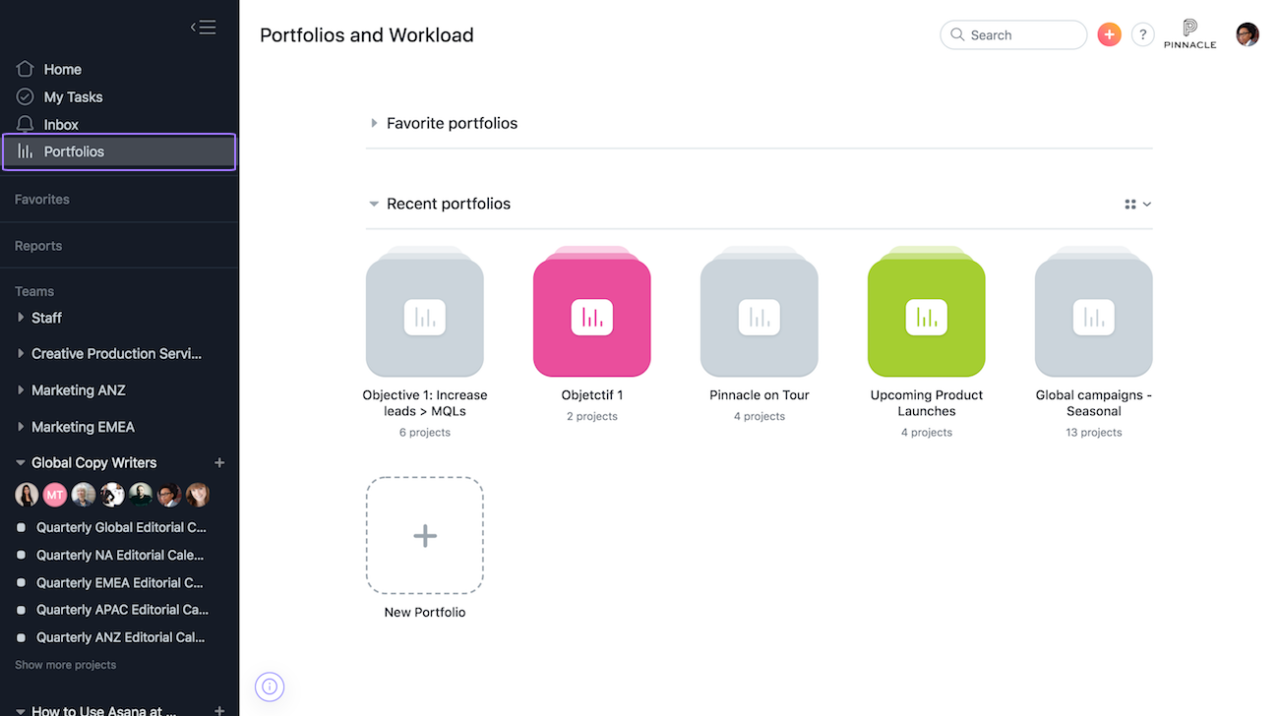
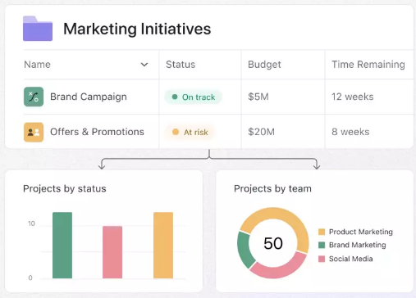
Reporting
Portfolios: Monitor important projects

Slide 10
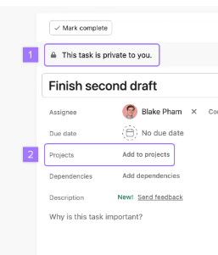
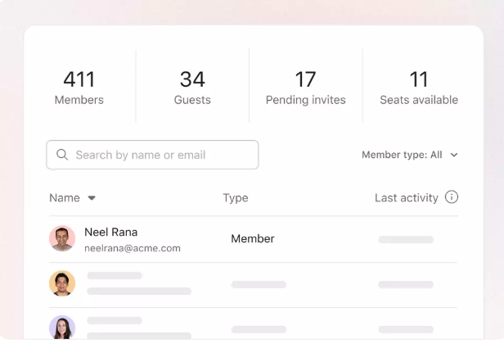
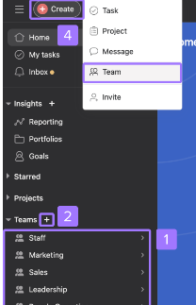
Team management
Users can create teams, add collaborators, manage permissions, and control access to projects.
Asana also offers admin controls for managing organizational settings and data security features.

Slide 11
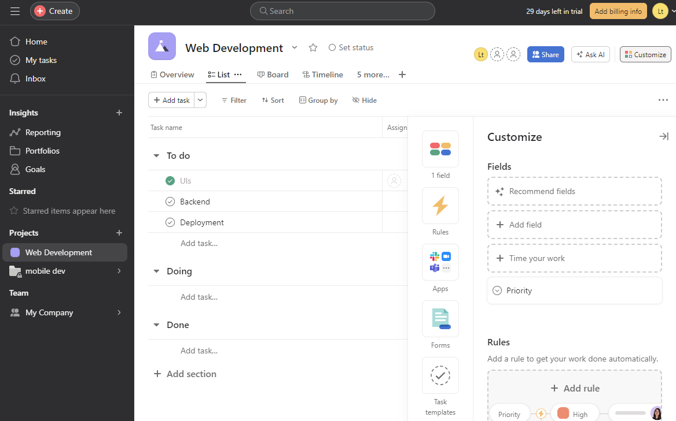
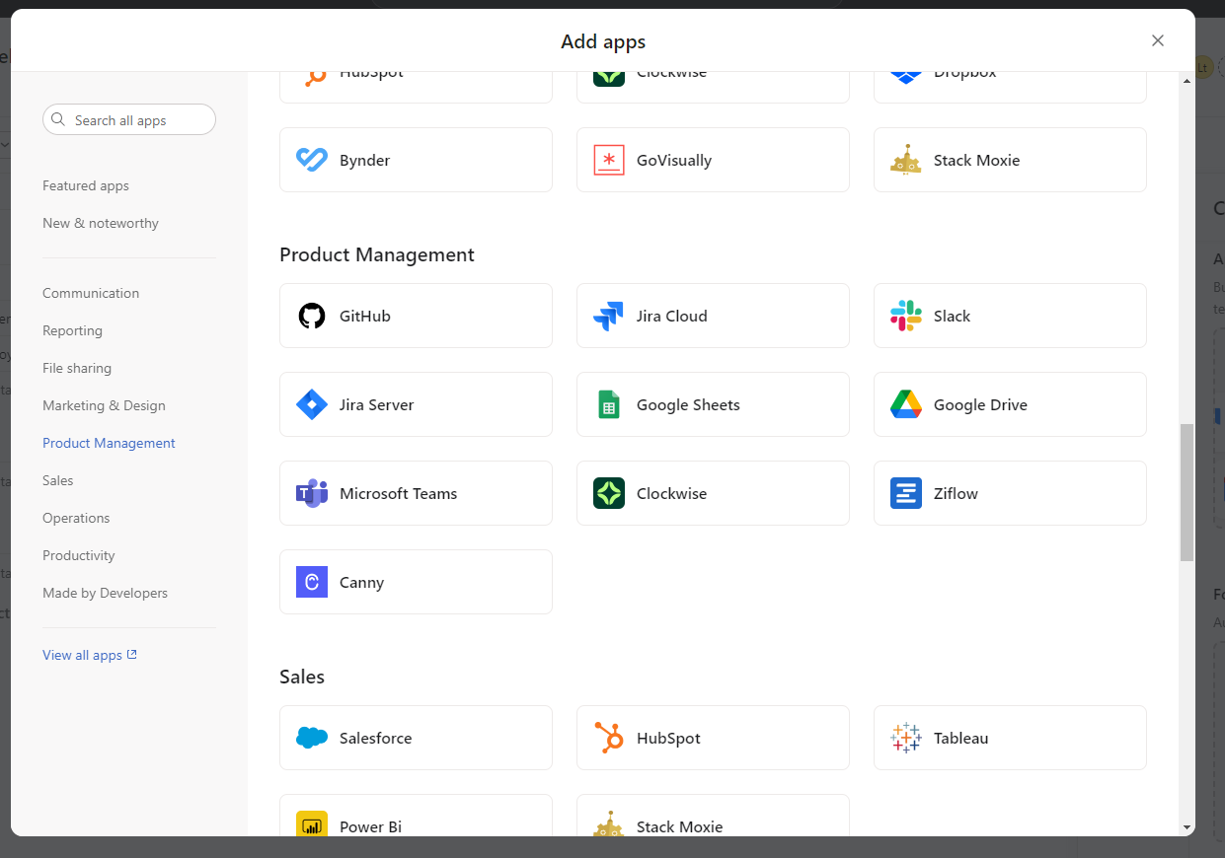
Integrations
File Creation and Sharing: Dropbox, Google Drive, Box, Adobe Creative Cloud
Communication: Slack, Asana for Gmail, Asana for Outlook, Zoom
Other Top Integrations: Google, Microsoft, Salesforce, JIRA Cloud, Harvest

Slide 12
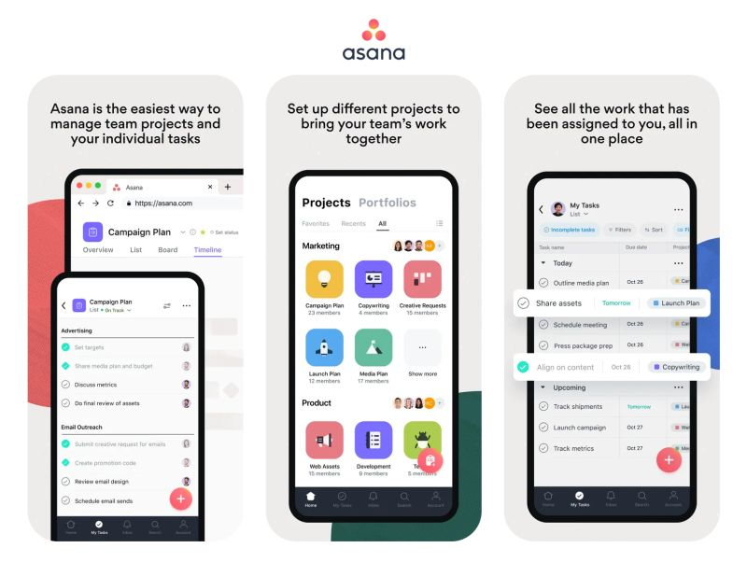
Mobile
In addition to the web app, Asana also offers mobile apps for iOS and Android.
Most features may differ between device types and with our full web app.

Slide 13


Any Questions? No? Why Not?

